Slide 1
💻 🖥 📱
Mockups for your keynotes
Made with ❤️ by Arthur Guillermin Hazan

Slide 2
iPhone 8
iPhone X
Drag & Drop your JPG/MOV (If video, Check Autoplay on the right panel).
Then select this shape and the jpg and press ⌘+⇧+M
Drag & Drop your JPG/MOV (If video, Check Autoplay on the right panel).
Then select this shape and the jpg and press ⌘+⇧+M

Slide 3
iPhone X + Safari
Drag & Drop your JPG/MOV (If video, Check Autoplay on the right panel).
Then select this shape and the jpg and press ⌘+⇧+M

Slide 4
Minimal iPhone X Blanc
Minimal iPhone X Noir
Drag & Drop your JPG/MOV (If video, Check Autoplay on the right panel).
Then select this shape and the jpg and press ⌘+⇧+M
Drag & Drop your JPG/MOV (If video, Check Autoplay on the right panel).
Then select this shape and the jpg and press ⌘+⇧+M

Slide 5
Minimal iPhone Blanc
Drag & Drop your JPG/MOV (If video, Check Autoplay on the right panel).
Then select this shape and the jpg and press ⌘+⇧+M

Slide 6
Minimal iPhone X Blanc without Notch
Drag & Drop your JPG/MOV (If video, Check Autoplay on the right panel).
Then select this shape and the jpg and press ⌘+⇧+M
Drag & Drop your JPG/MOV (If video, Check Autoplay on the right panel).
Then select this shape and the jpg and press ⌘+⇧+M

Slide 7
Minimal Phone White
Minimal Phone Black
Drag & Drop your JPG/MOV (If video, Check Autoplay on the right panel).
Then select this shape and the jpg and press ⌘+⇧+M
Drag & Drop your JPG/MOV (If video, Check Autoplay on the right panel).
Then select this shape and the jpg and press ⌘+⇧+M

Slide 8
Drag & Drop your JPG/MOV (If video, Check Autoplay on the right panel).
Then select this shape and the jpg and press ⌘+⇧+M

Slide 9
Minimal Tablet White
Minimal Phone Black
Drag & Drop your JPG/MOV (If video, Check Autoplay on the right panel).
Then select this shape and the jpg and press ⌘+⇧+M
Drag & Drop your JPG/MOV (If video, Check Autoplay on the right panel).
Then select this shape and the jpg and press ⌘+⇧+M

Slide 10
Minimal Macbook
Drag & Drop your JPG/MOV (If video, Check Autoplay on the right panel).
Then select this shape and the jpg and press ⌘+⇧+M

Slide 11
Minimal Macbook with browser (Chrome)
It’s customizable
Website Title
www.replaceyourURL.fr
Drag & Drop your JPG/MOV (If video, Check Autoplay on the right panel).
Then select this shape and the jpg and press ⌘+⇧+M

Slide 12
It’s customizable
Chrome only
Website Title
www.replaceyourURL.fr
Drag & Drop your JPG/MOV (If video, Check Autoplay on the right panel).
Then select this shape and the jpg and press ⌘+⇧+M

Slide 13
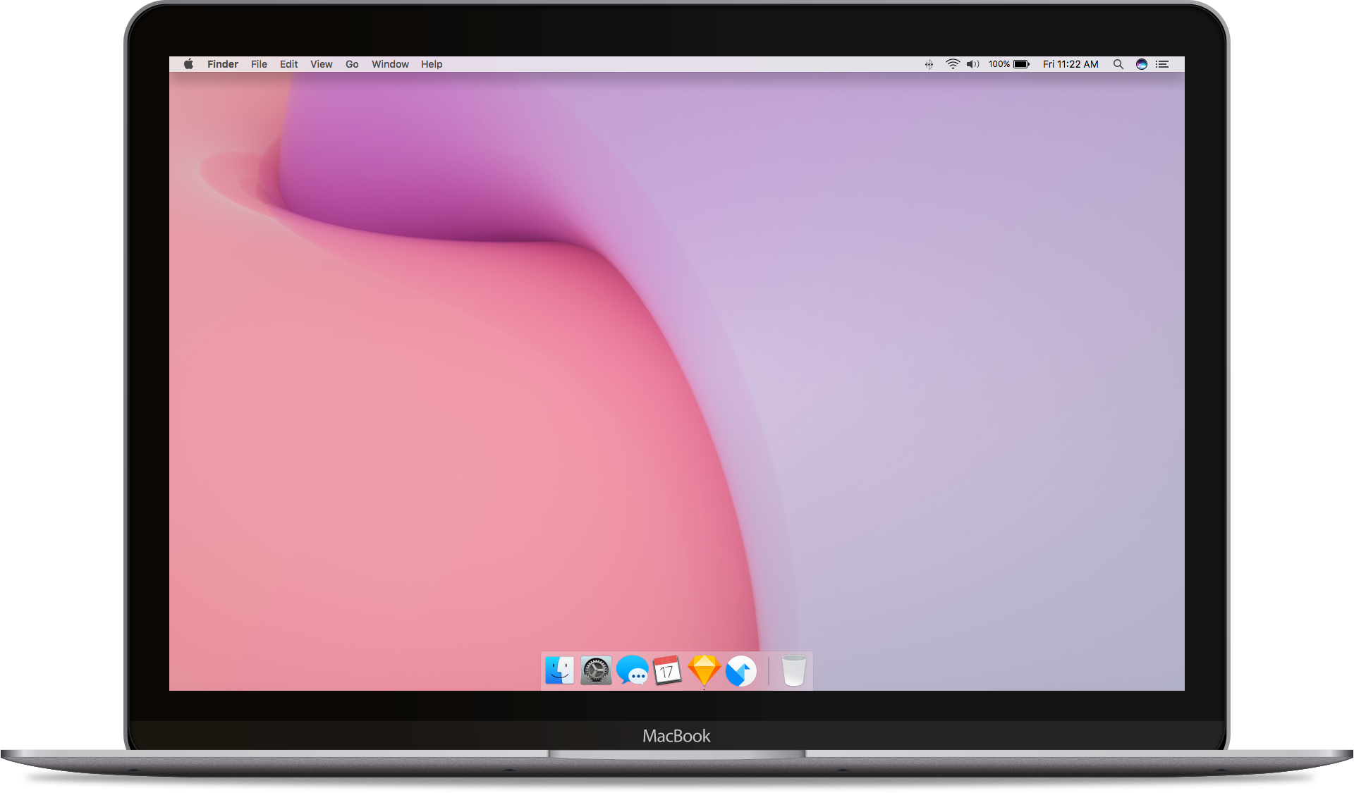
New Macbook + Chrome
Minimal Macbook with browser
Website Title
www.replaceyourURL.fr
Drag & Drop your JPG/MOV (If video, Check Autoplay on the right panel).
Then select this shape and the jpg and press ⌘+⇧+M

Slide 14
Cursors
to highlight elements
Simple Cursor
Simple Pointer
Drag Cursors
Move anywhere
Move Up Down
Move Right Left

