Slide 1

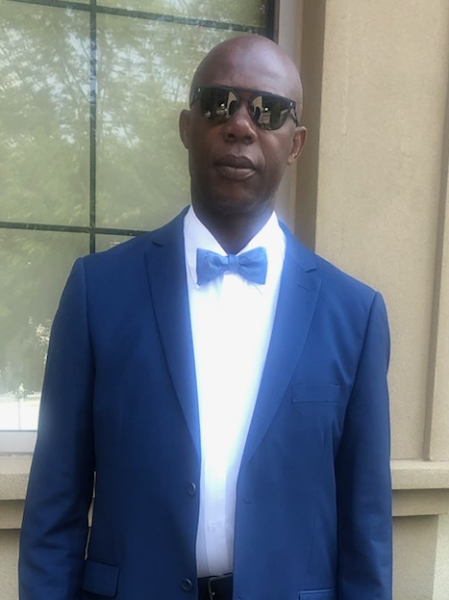

2705 Young Avenue Bronx, NY 10469
Office: 718-994-3118
Cell: 347-512-0108
godfreymitchell@aol.com
www.godfreymitchell.com
Recovering your rightful compensation
right from the start
© 2020 Martha Lynn Laskie Graphic Design& Illustration. | Become Impressive™. www.mllgd.com
LICENSED IN NY, NJ, CT, PA, NC, SC, GA, TX & FL

